Slide 1

MATH24 Differential Equations

Slide 2
Definitions
Arbitrary Constants and Parameters
An arbitrary constant is a constant that does not have a fixed value and is eliminated from an equation to form its differential equation while a parameter, usually treated as a constant, is not to be eliminated.

Slide 3
Steps in Eliminating Arbitrary Constants
Differentiate the equation as many times as the number of arbitrary constants.
Eliminate the arbitrary constants from the equation and its derivatives by a suitable method.
Notes:
The desired differential equation is free from arbitrary constants.
The order of the resulting differential equation should be equal to the number of arbitrary constants.

Slide 4
Examples
Find the differential equations of the following by eliminating the arbitrary constants.
y = 3x² + ce^{−2x}
y = C₁sin4x + C₂cos4x + x
y = (x + c)e^{−x}
x + y = tan(x + c) Recall: tan⁻¹u = (du/dx)/(1 + u²)
(x − a)² + y² = a² Families of Circles with center at (a, 0) and passing through the origin.

Slide 5
Families of Curves
A family of curves is usually defined by an equation containing one or more arbitrary constant and sometimes a parameter.
The differential equation of the family of curves is obtained by eliminating the arbitrary constants.

Slide 6
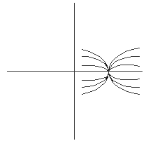
Examples
Family of parabolas with vertex at (1, 3) and axis parallel to the x-axis.

Slide 7
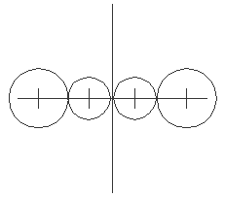
Examples
All straight lines with slope and y-intercept equal.
Family of circles with center on the x-axis.

Slide 8
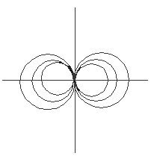
Examples
Circles through the origin with center on the x-axis.

Slide 9
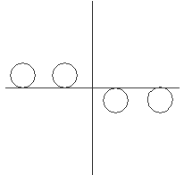
Examples
Family of circles with fixed radius r and tangent to the x-axis.

Slide 10
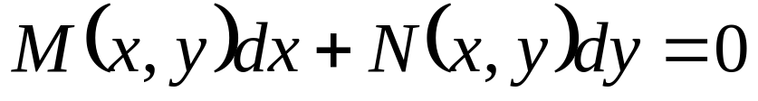
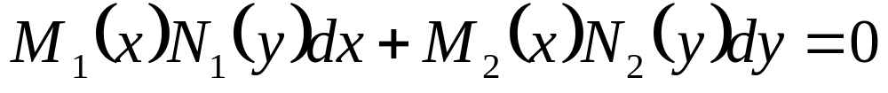
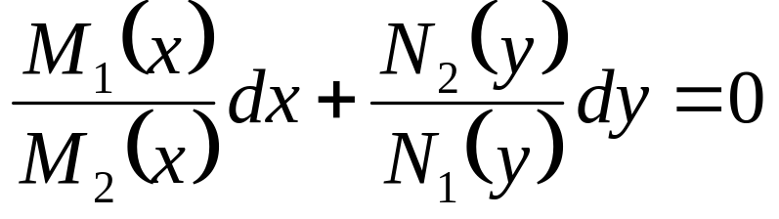
Separation of Variables
Given the general form of the differential equation,
Suppose M(x,y) and N(x,y) can be expressed as distinct functions of x and y that is, M₁(x)N₁(y) and M₂(x)N₂(y) respectively, then the equivalent equation is
which can be transformed to
by means of separation of variables.

Slide 11
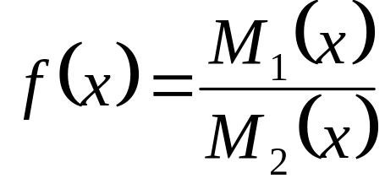
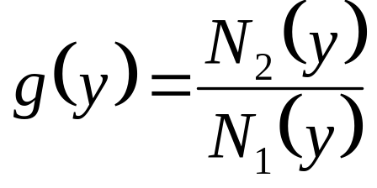
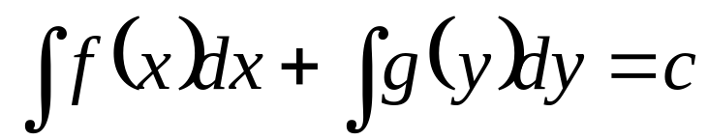
Separation of Variables
If and , then the general
solution will be
Note:
To separate the variables, divide the equation by the unnecessary factor(s) in each term or multiply the equation by the reciprocal of these unnecessary factors.
Unnecessary factors are factors which make a term unintegrable.

Slide 12
Examples
Obtain the general solution of the following differential equations.
3x²ydx − x³dy = 0
cosxsinydx + sinxcosydy = 0
2x(1 + y²)dx − y(1 + 2x²)dy = 0
(y² − 1)dx − 2y(2 + x)dy = 0
xsinydx + e^{−x}dy = 0
2y²dx + (x²y − 2xy)dy = 0

Slide 13
Homogeneous Function
The function f(x,y) = 0 is called a homogeneous function of degree n if and only if f(kx,ky) = k^{n}f(x,y).

Slide 14
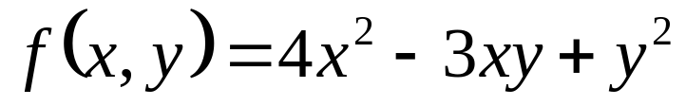
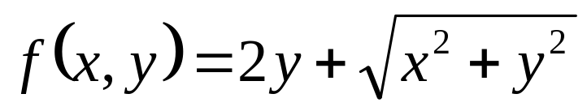
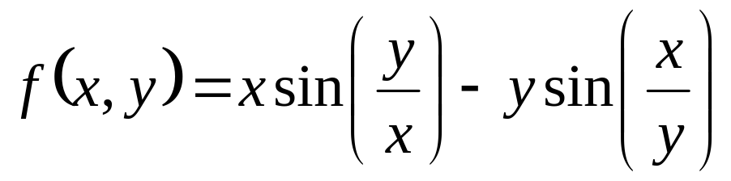
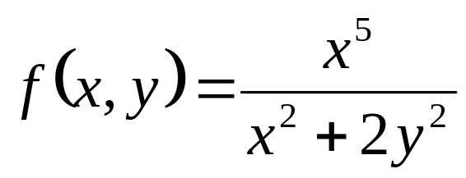
Examples
Test whether the given function is homogeneous or not, if it is homogeneous then give the degree.

